Slide 1
MOLECULAR BIOLOGY LABORATORY
BT 453
Laboratory No. 2
Plasmid Extraction
MBL. BT453

Slide 2
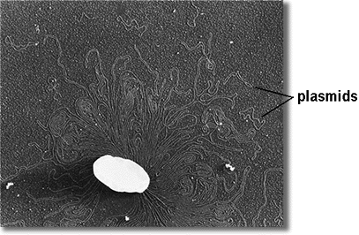
Plasmids
Small, double stranded, circular pieces of DNA
Replicate independently (self-replication) or within the host genome (episomes)
Plasmids have relatively few genes, generally less than 30,
Plasmids
E. coli
Chromosome
MBL. BT453

Slide 3
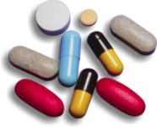
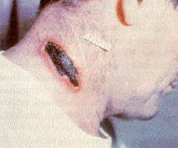
Types of Plasmids
  Conjugative plasmids
    Transmitted during conjugation, carry a variety of information
  R plasmids (resistance plasmids)
    protect against environmental factors, MDR (multiple drug resistance)
  Hfr plasmids:
    Promotes genomic recombination
  Col-plasmids:
    Codes for proteins that kill other microbes
  Degradative plasmids:
    Contain sequencing that allows host to digest uncommon substances
    (ex: toluene, salicylic acid)
  Virulence plasmids:
    Codes for altering the microbe into a pathogen
MBL. BT453
MBL

Slide 4
Alkaline Adsorption method (Promega kit)
Bacteria pellting
&
resuspension in TE (Tris-EDTA)
EDTA binds up Mg++ ions, which is a necessary cofactor of DNases, which degrade the DNA. These ions interfere with the action of detergents. The EDTA binds to them(ions), sequestering them and preventing their interference.
TRIS – to maintain the pH of the DNA
A
Bacteria Lysis with
Detergent (SDS)
&
NaOH
SDS denature proteins, disrupts the lipid layers, helps to dissolve membranes & binds positive charges of chromosomal proteins (histones) to release the DNA into the solution.
NaOH denature chromosomal DNA & plasmids
B
Neutralization of NaOH with potassium acetate solution
Potassium acetate Neutralizes NaOH, renatures plasmid DNA quickly while high Mwt chromosomal DNA become tangled due to its complexity & precipitate. Plasmid remains in the solution.
Converts soluble SDS to insoluble PDS
C
MBL. BT453

Slide 5
Alkaline Adsorption method (Promega kit)
Adsorption of plasmid DNA into silica membrane
Sodium Salt act as a cation bridge between the silica & the plasmid DNA
D
Washing of plasmid
Ethanol
Salt
E
F
plasmid elution
DNAse-free water removes choatropic salt and sodium salt.
MBL. BT453

Slide 6

Differential solubility / Organic solvents
A
B
Centrifuge
Remove media & resuspend in TE
Add lysis buffer SDS + NaoH
Overnight bacterial culture
Bacteria pellet
Cells are lysed, plasmid DNA in solution
MBL. BT453

Slide 7
Plasmid DNA (Supercoiled)
Alkali
Linear Chromosomal DNA
MBL. BT453

Slide 8
Differential solubility / Organic solvents
C
Neutralize with potassium acetate solution then centrifuge
Crude lysate containing plasmid DNA and other cell constituents
MBL. BT453

Slide 9
Plasmid DNA (Supercoiled)
Alkali
Linear Chromosomal DNA
Neutralize
Plasmid DNA (Supercoiled)
Tangled Chromosomal DNA
MBL. BT453

Slide 10
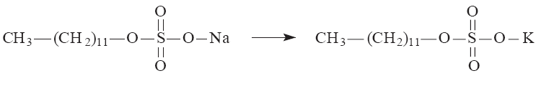
Potassium acetate precipitation of SDS
sodium dodecyl sulfate (SDS) potassium dodecyl sulfate (PDS)‏
(H₂O sol. = 10%) (H₂O sol. < 0.02%)‏
MBL. BT453

Slide 11



Differential solubility / Organic solvents
C
D
Neutralize with potassium acetate solution then centrifuge
Apply to column
Centrifuge
Plasmid
Silica-gel membrane
Flow through
(discard)
Plasmids bind to the membrane, while contaminants pass through the column.
Crude lysate containing plasmid DNA and other cell constituents
Supernatant contains Plasmid DNA, Soluble cellular constituents.
Pellet contains PDS,Lipids, Proteins & Chromosomal DNA
E
Continue washing with ethanol/salt & elution with nuclease-fee water or TE
F
MBL. BT453

